Slide 1





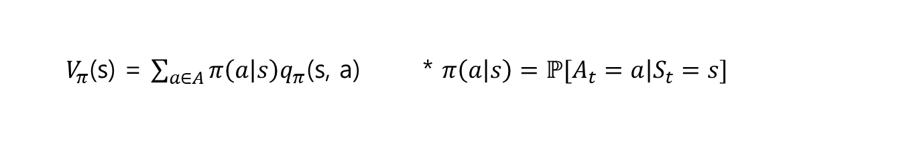
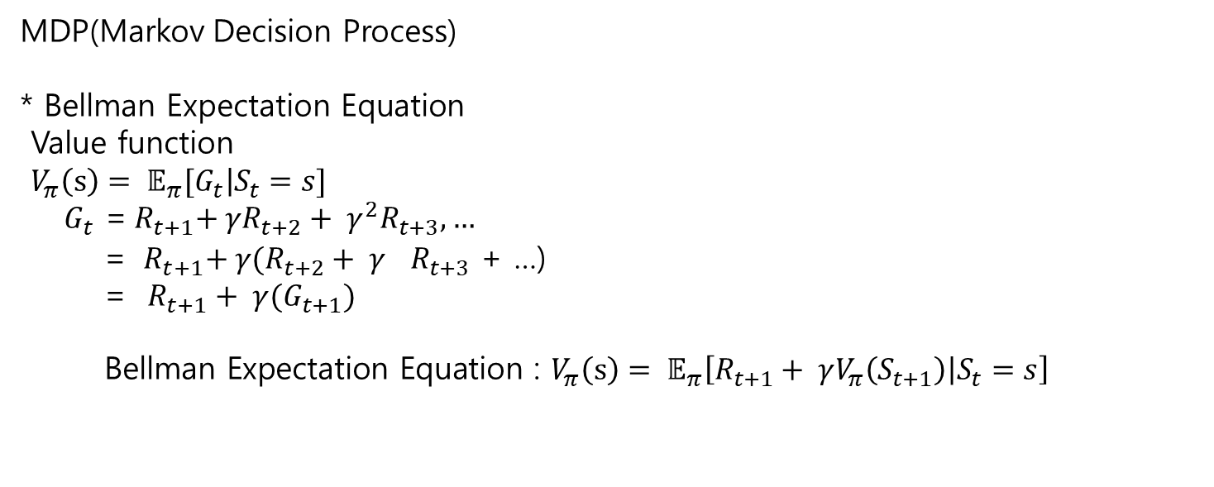





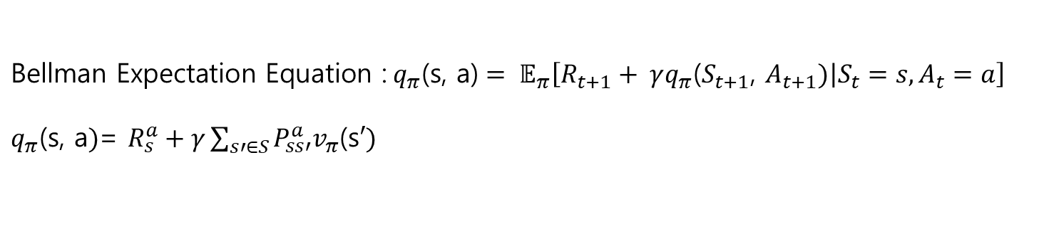


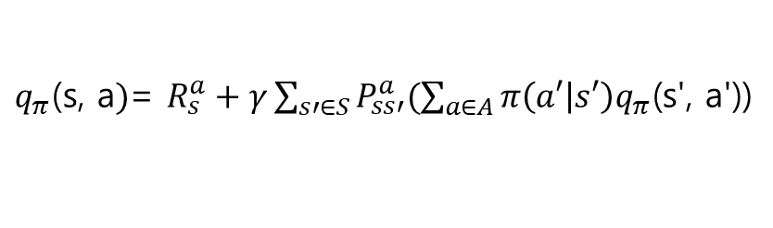
MDP(Markov Decision Process)
* Bellman Expectation Equation
Value function
$V_{π}\left(s\right)= 𝔼_{π}[\left.G_{t}\right|S_{t}=s]$
$G_{t}$ =${{ R}_{t+1}+ γR_{t+2}+ γ^{2}R_{t+3}, …}_{}$
= ${ R}_{t+1}+ γ(R_{t+2}+ γ^{}R_{t+3}$ + …)
= $R_{t+1}+ γ(G_{t+1})$
${\text{Bellman} \text{Expectation} \text{Equation}\text{ :} V}_{π}\left(s\right)= 𝔼_{π}\left[\left.R_{t+1}+ γV_{π}\left(S_{t+1}\right)\right|S_{t}=s\right]$
*들어가기 전
A = {a1, a2, a3}
S
$$π\left(a1 | s\right)$$
A1
$q_{π}\text{(}\text{s}\text{, }\text{a}\text{1}$)
$$V_{π}\left(s\right)$$
$$π\left(a2 | s\right)$$
A2
$q_{π}\text{(}\text{s}\text{, }\text{a}\text{2}$)
$$π\left(a3 | s\right)$$
A3
$q_{π}\text{(}\text{s}\text{, }\text{a}\text{3}$)
${ V}_{π}$(s) = $\sum_{a∈A}{π\left(a | s\right)q_{π}\text{(}\text{s}\text{, }\text{a}\text{)}}$ * $π\left(a | s\right)=ℙ[\left.A_{t}=a\right|S_{t}=s]$
$${\text{Bellman} \text{Expectation} \text{Equation}\text{ :} q}_{π}\text{(}\text{s}\text{, }\text{a}\text{)}= 𝔼_{π}\left[\left.R_{t+1}+ γq_{π}\text{(}S_{t+1}\text{,} A_{t+1})\right|S_{t}=s,A_{t}=a\right]$$
$q_{π}\text{(}\text{s}\text{, }\text{a})$= $R_{s}^{a}+γ\sum_{s′∈S}{P_{ss′}^{a}v_{π}\text{(}\text{s}′)}$
$∗ R_{s}^{a}$ = $𝔼[\left.R_{t+1}\right|S_{t}=s,{ A}_{t}=a]$
$∗P_{ss′}^{a}$=$ℙ[\left.S_{t+1}= s^{′} \right|S_{t}=s,A_{t}=a]$
${ V}_{π}$(s) = $\sum_{a∈A}{π\left(a | s\right){(R}_{s}^{a}+γ\sum_{s′∈S}{P_{ss′}^{a}v_{π}\text{(}\text{s}′)}}$)
S’
A
$q_{π}\text{(}\text{s}\text{, }\text{a}$)
$$V_{π}\left(s′\right)$$
$q_{π}\text{(}\text{s}\text{, }\text{a})$= $R_{s}^{a}+γ\sum_{s′∈S}{P_{ss′}^{a}(\sum_{a∈A}{π\left(a′ | s′\right)q_{π}\text{(}\text{s}\text{′}\text{, }\text{a}\text{′}\text{)}\text{)}}}$

Slide 2
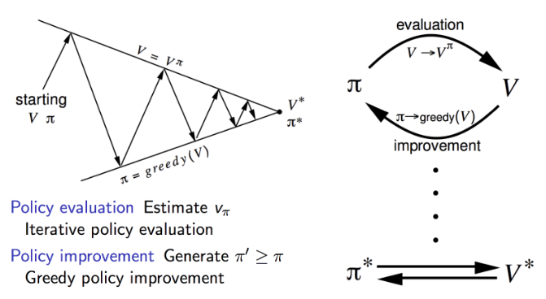
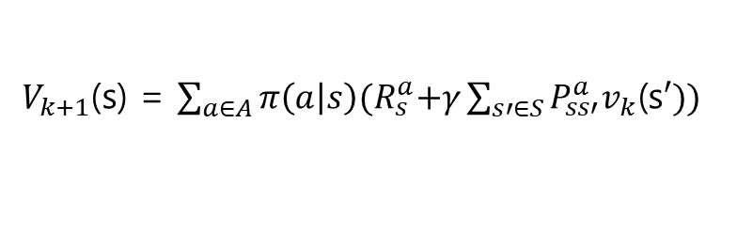
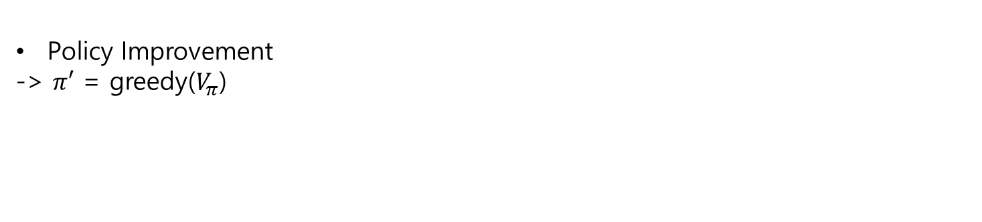

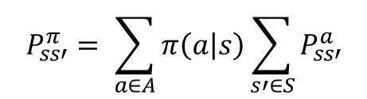



*들어가기 전
MDP(Markov Decision Process)
Policy evaluate
Using synchronous backups
->At each iteration k + 1
->For all states s ∈ S
->Update $V_{k+1}\left(s\right)$ from $V_{k}\left(s′\right)$
->Where s’ is a successor state of s
$$\text{Bellman} \text{Expectation} \text{Equation}$$
${ V}_{k+1}$(s) = $\sum_{a∈A}{π\left(a | s\right){(R}_{s}^{a}+γ\sum_{s′∈S}{P_{ss′}^{a}v_{k}\text{(}\text{s}′))}}$
$$R_{s}^{π}= \sum_{a∈A}{π\left(a | s\right)R_{s}^{a}}$$
$$V^{k+1}=R_{s}^{π}+ γP_{ss′}^{π}V^{k}$$
$$P_{ss′}^{π}= \sum_{a∈A}{π\left(a | s\right)\sum_{s′∈S}{P_{ss′}^{a}}}$$
Policy Improvement
-> $π′$ = greedy($V_{π}$)

Slide 3
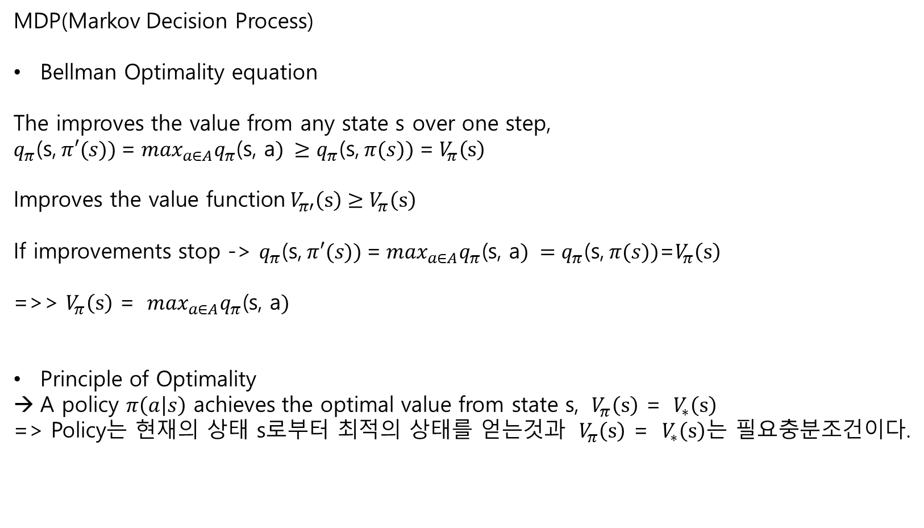
*들어가기 전
MDP(Markov Decision Process)
Bellman Optimality equation
The improves the value from any state s over one step,
$q_{π}\text{(}\text{s}\text{,} π′(s))$=$\max_{a∈A}q_{π}\text{(}\text{s}\text{, }\text{a}) ≥q_{π}\text{(}\text{s}\text{,} π(s)) \text{=}{ V}_{π}\left(s\right)$
$${\text{Improves} \text{the} \text{value} \text{function} V}_{π′}\left(s\right)≥V_{π}\left(s\right)$$
If improvements stop -> $q_{π}\text{(}\text{s}\text{,} π′(s))$=$\max_{a∈A}q_{π}\text{(}\text{s}\text{, }\text{a}) =q_{π}\text{(}\text{s}\text{,} π(s))\text{=}V_{π}\left(s\right)$
=>> $V_{π}\left(s\right)$ = $\max_{a∈A}q_{π}\text{(}\text{s}\text{, }\text{a})$
Principle of Optimality
A policy $π\left(a | s\right)$ achieves the optimal value from state s, ${ V}_{π}\left(s\right)$ = ${ V}_{∗}\left(s\right)$
=> Policy는 현재의 상태 s로부터 최적의 상태를 얻는것과 ${ V}_{π}\left(s\right)$ = ${ V}_{∗}\left(s\right)$는 필요충분조건이다.

Slide 4

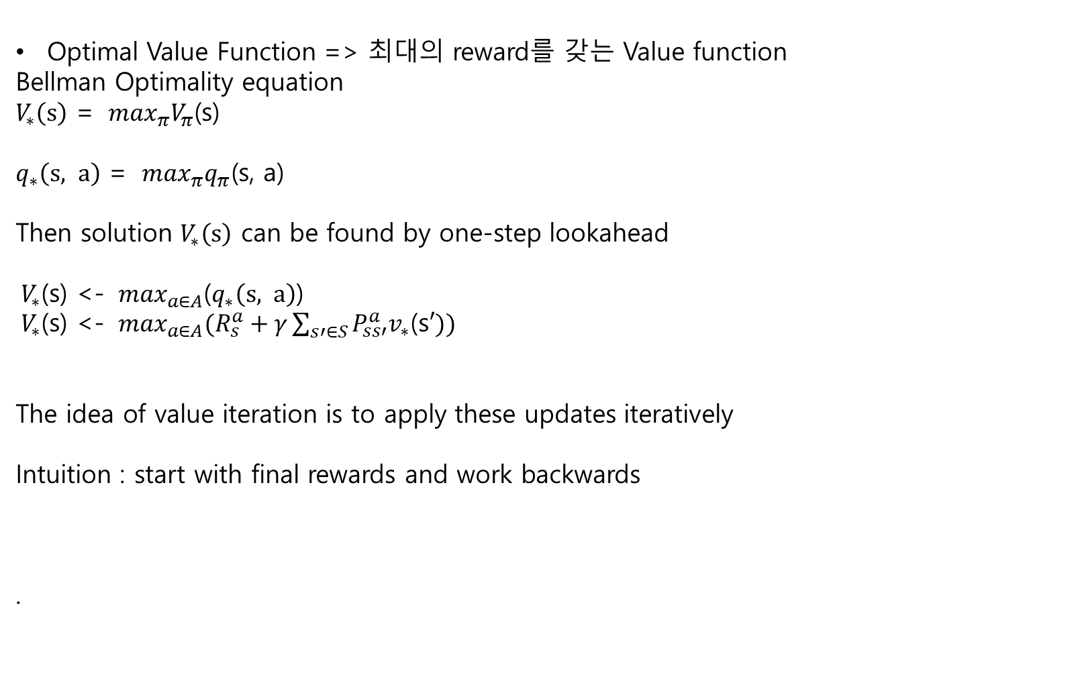


Value
Iteration
Optimal Value Function => 최대의 reward를 갖는 Value function
Bellman Optimality equation
$V_{∗}\left(s\right)$ = $\max_{π}V_{π}\text{(}\text{s}\text{)}$
$q_{∗}\left(s, a\right)$ = $\max_{π}q_{π}\text{(}\text{s}\text{, }\text{a}\text{)}$
Then solution $V_{∗}\left(s\right)$ can be found by one-step lookahead
${ V}_{∗}$(s) <- $\max_{a∈A}$($q_{∗}\left(s, a\right)$)
${ V}_{∗}$(s) <- ${\max_{a∈A}(R}_{s}^{a}+γ\sum_{s′∈S}{P_{ss′}^{a}v_{∗}\text{(}\text{s}′)})$
The idea of value iteration is to apply these updates iteratively
Intuition : start with final rewards and work backwards
.
${ V}_{∗}$(s)
$q_{∗}\left(s, a1\right)$
$q_{∗}\left(s, a2\right)$

Slide 5
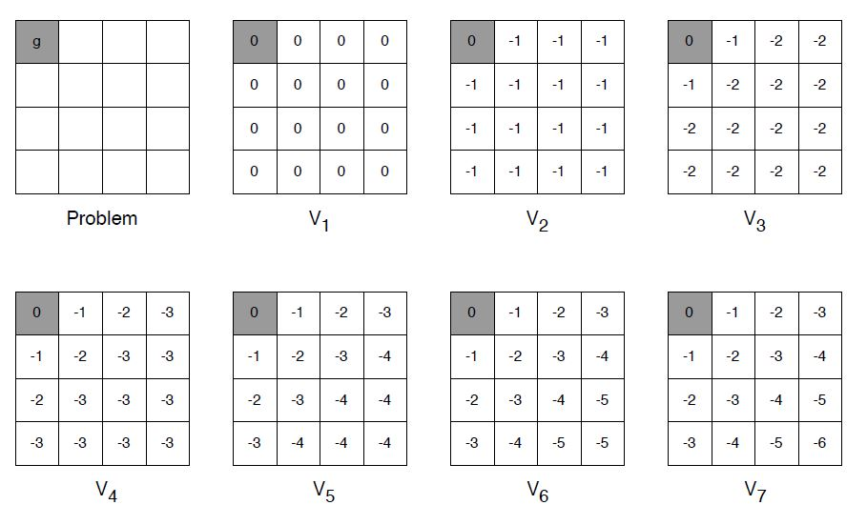
Value
Iteration
:Example
Shortest Path (discount = 1.0, reward = -1)
.

Slide 6
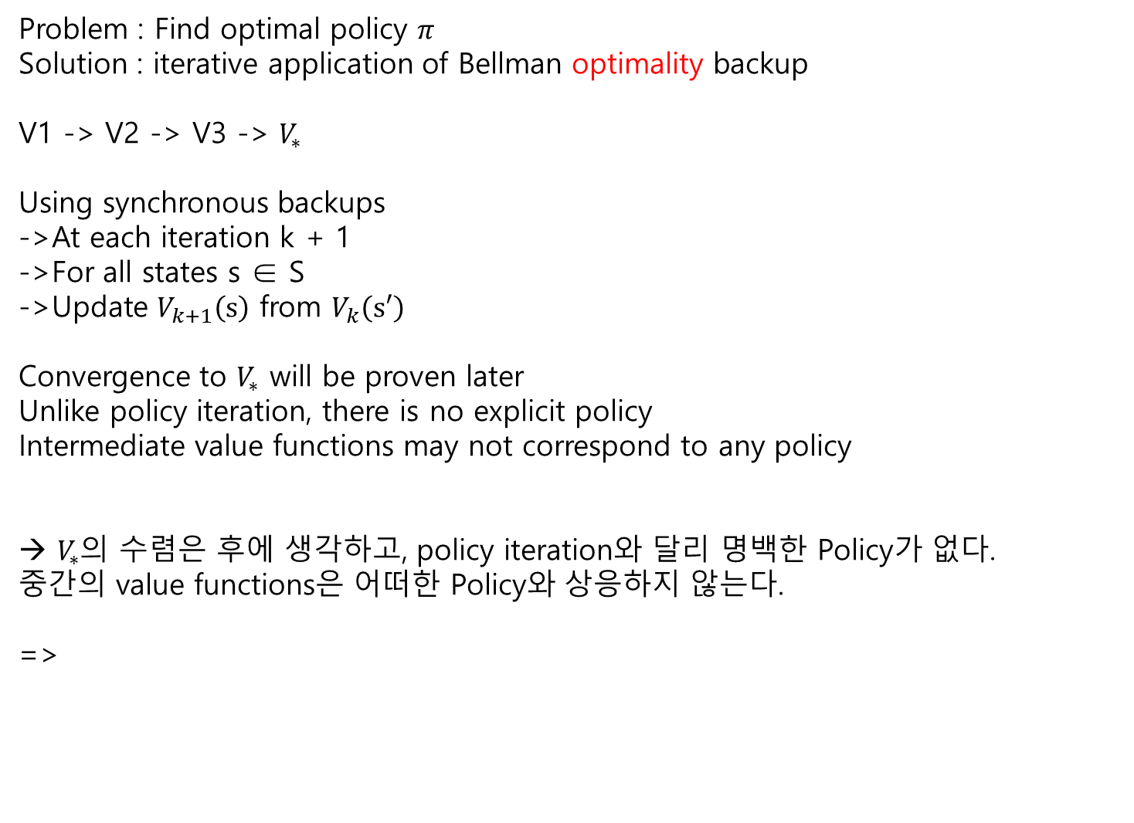
Value
Iteration
Problem : Find optimal policy $π$
Solution : iterative application of Bellman optimality backup
V1 -> V2 -> V3 -> $V_{∗}$
Using synchronous backups
->At each iteration k + 1
->For all states s ∈ S
->Update $V_{k+1}\left(s\right)$ from $V_{k}\left(s′\right)$
Convergence to $V_{∗}$ will be proven later
Unlike policy iteration, there is no explicit policy
Intermediate value functions may not correspond to any policy
→ $V_{∗}$의 수렴은 후에 생각하고, policy iteration와 달리 명백한 Policy가 없다.
중간의 value functions은 어떠한 Policy와 상응하지 않는다.
=>

Slide 7


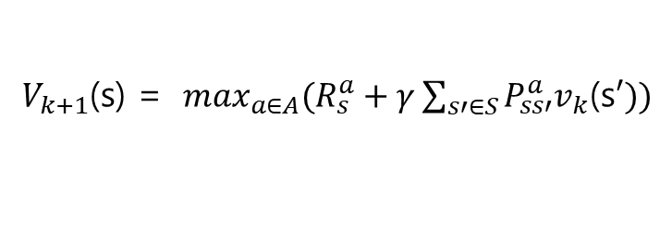

Value
Iteration
${ V}_{k+1}$(s) <- s
$$a$$
${ V}_{k}$(s’) <- s’
${ V}_{k+1}$(s) = ${\max_{a∈A}(R}_{s}^{a}+γ\sum_{s′∈S}{P_{ss′}^{a}v_{k}\text{(}\text{s}′))}$
중간중간에 Policy를 update하지 않고 마지막에 구해진 $q_{∗}\left(s, a\right)의$ 값을 보고 greedy하게 policy를 정해버린다.

